Slide 1
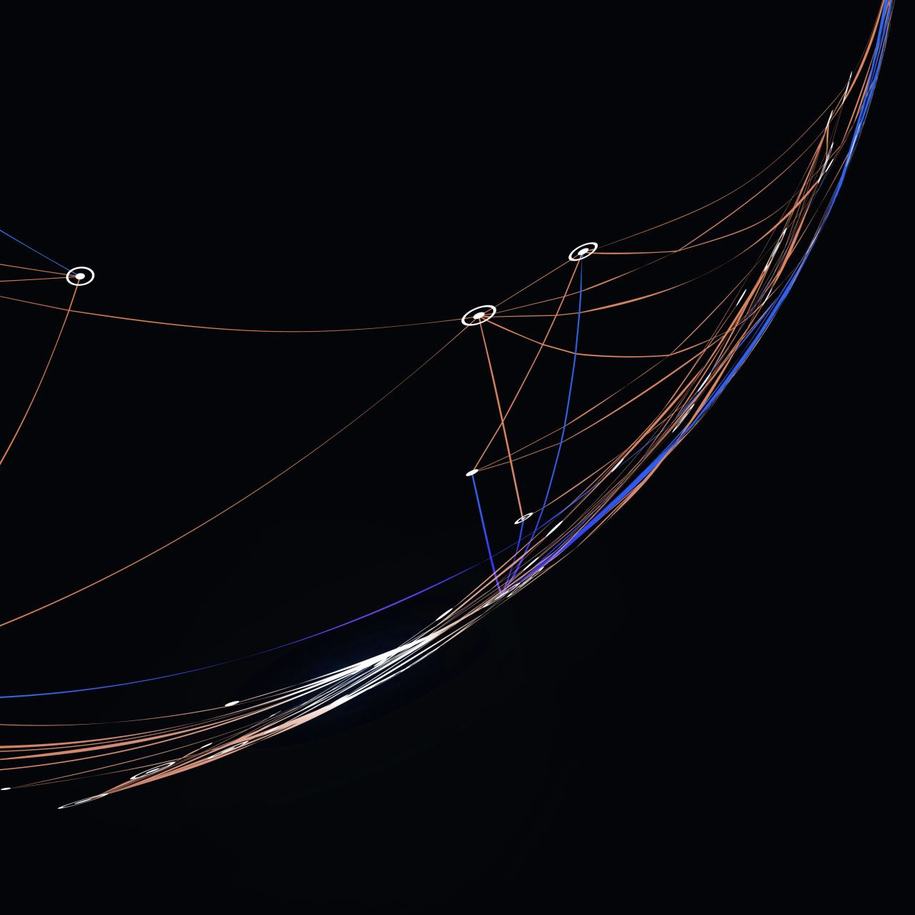
Azure Kubernetes Workshop
Day 2:
Intermediate Kubernetes Concepts

Slide 2
Agenda
Config Maps, Secrets
Storages and Persistent Volumes
Azure Key Vault
Multi-Container Pods
Init Containers
Daemon Sets
Health Probes
Authentication/Authorization
Jobs, Cron Jobs

Slide 3
Pod Environment Variable
When working with containers in Docker, you can define environment variables when you create your containers, either individually or by specifying a file
docker run -e MYVAR1=boo --env MYVAR2=foo --env-file ./env.list ubuntu
When creating Pods, you can specify environment variables as a list of name/value pairs in the container’s specification.
If you want to use an entire file full of environment variables, you can create a ConfigMap and reference all or part of it in the container’s specification.

Slide 4
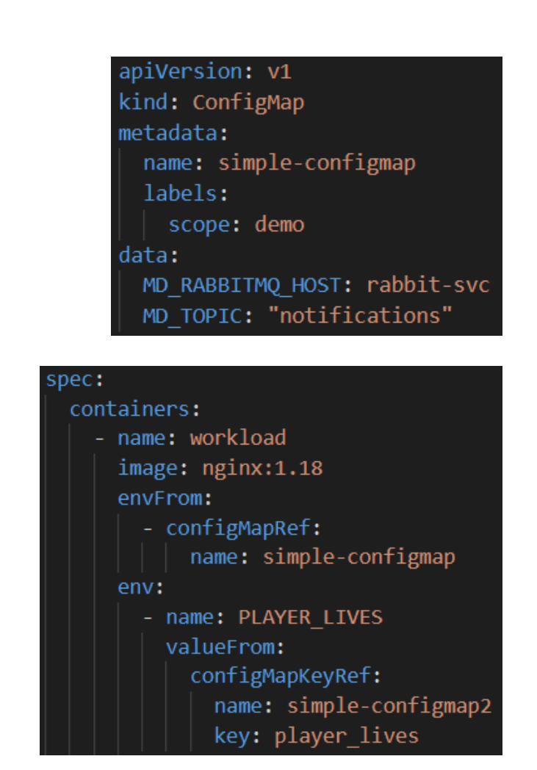
Config Map
A ConfigMap is used to store non-confidential data as key-value pairs.
They allows decoupling environment-specific configuration from container instances.
Containers can consume ConfigMaps as environment variables.
Containers can use an entire ConfigMap or only selected values.
ConfigMaps can be referenced by multiple Containers in different Pods

Slide 5
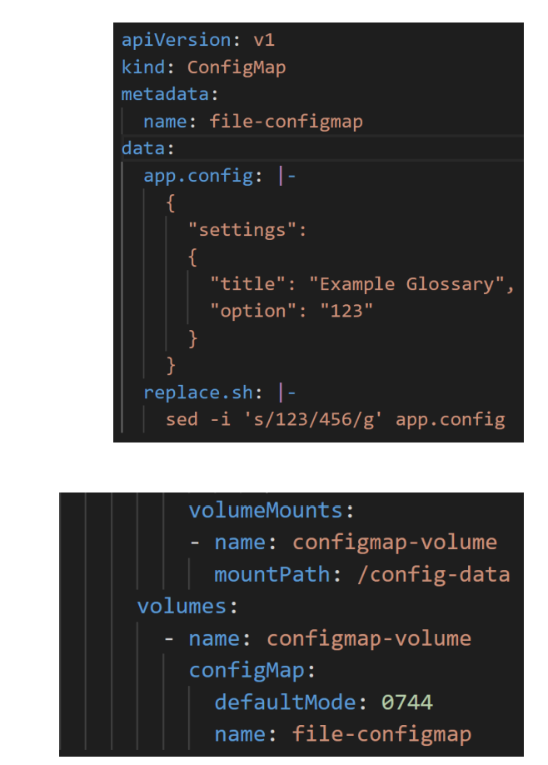
Config Map Mounted as Volumes
ConfigMaps can also contain entire file definitions.
These ConfigMaps can be attached as Volumes in a Pods and mounted as read-only folders in containers.
Each entry in a ConfigMaps is mounted as a separate file.
If scripts are defined in ConfigMaps, they can be automatically mounted with executable permissions, using the defaultMode setting

Slide 6
Config Map Demo
Module3-instructions:
Exercise: Working with Multi-Container Pods, Ephemeral Volumes and ConfigMaps
Notes:
Module3-instructions:
Exercise: Working with Multi-Container Pods, Ephemeral Volumes and ConfigMaps

Slide 7
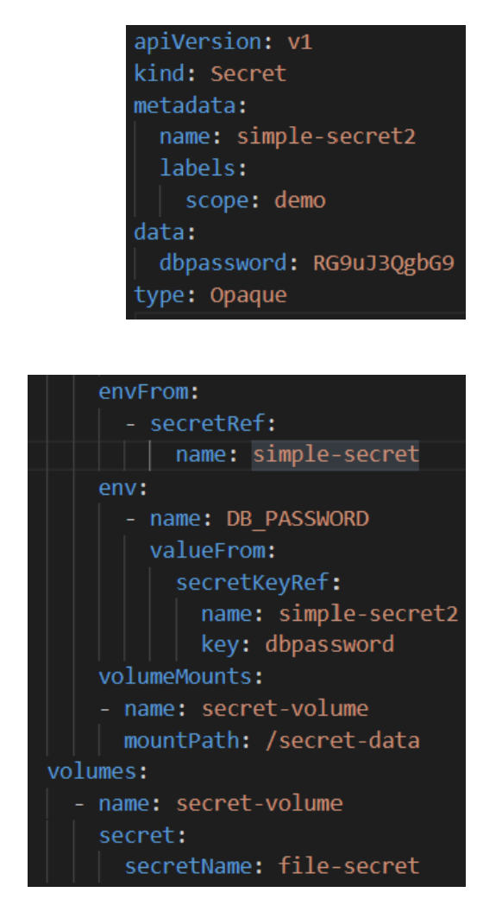
Secrets
Secrets are the same as ConfigMaps, except the data/files they hold is encoded.
They can be used to store and manage sensitive information, such as passwords, OAuth tokens, and ssh keys.
Storing confidential information in a Secret is safer and more flexible than setting it verbatim in a Pod definition or in a container image.
Other Kubernetes resources, like Ingresses and Persistent Volumes, also use Secrets as part of their configuration.

Slide 8
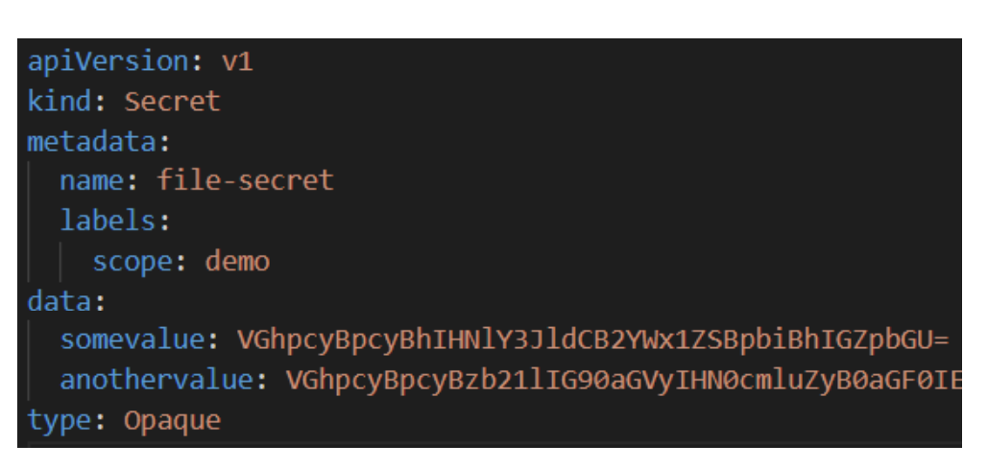
Secrets are Encoded, NOT Encrypted
Kubernetes Secrets are, by default, stored as unencrypted base64-encoded strings.
Secrets can be viewed as plain text by anyone with API access or anymore who can execute a printenv command in a container.
It’s recommended that you Enable or configure RBAC rules that restrict reading and writing of Secrets. Or inject, as needed, from Azure Key Vault.
You can generate a Secret object definition from literal values and output it directly to a yaml file, without creating the object in the Kubernetes database.
kubectl create secret generic test-secret --from-file=tls=/path/tls.key \ --from-literal=username=testuser -o yaml --dry-run > mysecret.yaml

Slide 9
Don’t Use Secrets to Store Sensitive Information
Kubernetes Secrets are encoded, NOT encrypted.
It’s not good practice to save sensitive content in YAML manifests or check Secrets resources into source control.
In a production environment, it's best to keep sensitive information in an external vault and inject that content only when and where it's needed.
Azure Kubernetes Service supports integration with Azure Key Vault to facilitate best practices when accessing sensitive information

Slide 10
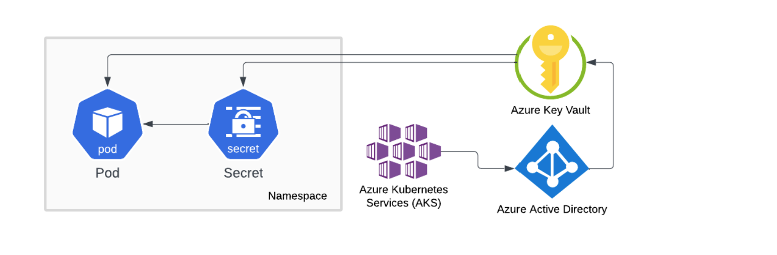
Azure Key Vault
Azure Kubernetes Service supports integration with Azure Key Vault to facilitate best practices when accessing sensitive information.
A Secret Store Provider can be enabled during the creation of a cluster.
AKS uses a managed identity to connect to Key Vault and dynamically create Kubernetes Secrets and/or inject secrets direct into containers.

Slide 11
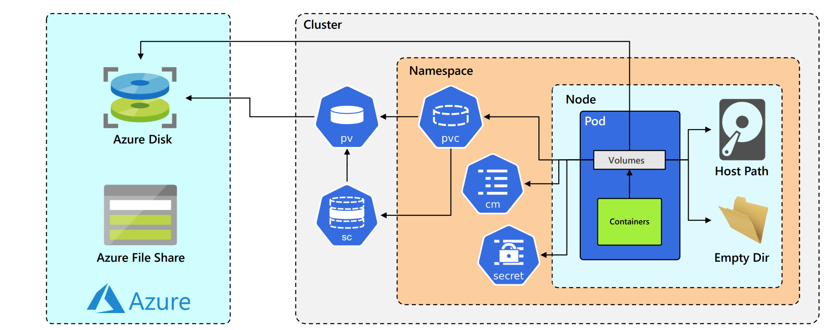
Kubernetes Volumes
Deleting or restarting a POD destroys any persistent data stored in the containers file system.
Ephemeral volume types have a lifetime of a pod, but persistent volumes exist beyond the lifetime of a pod.
At its core, a volume is a directory, possibly with some data in it, which is accessible to the containers in a Pod.
Azure Disk -> /mnt/external
A Pod can use any number of volume types simultaneously

Slide 12
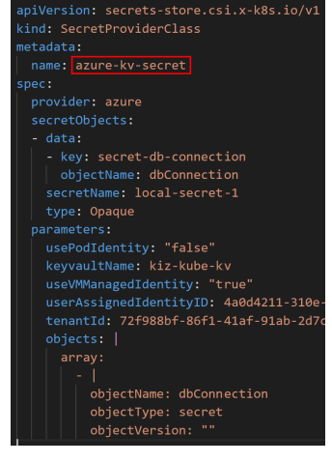
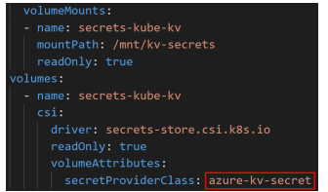
Azure Key Vault Integration
When Azure Key Vault is enabled in AKS, a custom resource called SecretProviderClass is available.
This manifest provides the connection information to Key Vault.
The secretObjects section is optional and only used if you want to create a Kubernetes Secret object.
When a Pod mounts the Secrets CSI volume, the Key Vault secret(s) is injected into the container (and a Secret object is created if specified).
If a Secret object is created, it’s automatically deleted when the last Pod that accesses that Secret is deleted

Slide 13
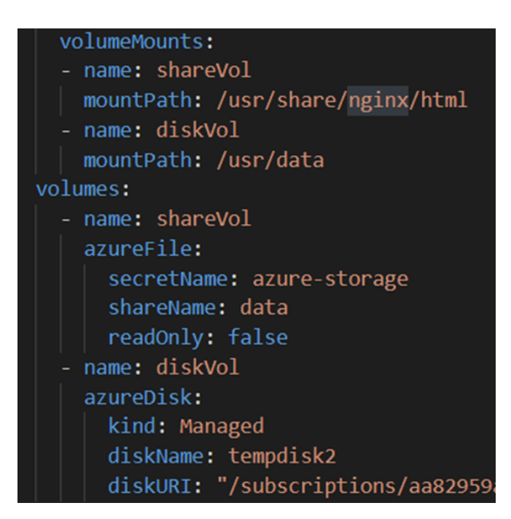
Ephemeral Volumes
Persistent volumes exist beyond the lifetime of a pod. Persistent volumes include:
Azure Disk – Mounts an Azure Data Disk into a pod.
Azure File – Mounts an Azure File Share (SMB 2.1/3.0) to a Pod.
Persistent Volume Claim - A way for users to "claim" durable storage without knowing the details of the cloud environment.

Slide 14
Persistent Volumes
A PersistentVolume (PV) resource is a piece of storage in the cluster that has been provisioned by an administrator or dynamically provisioned using Storage Classes.
PVs are volume plugins like Volumes but have a lifecycle independent of any individual Pod that uses the PV.
It is a cluster wide resource (not namespaced), available to for any user to claim. •
There are two ways PVs may be provisioned:
Statically - A cluster administrator creates multiple PVs that carry the details of the real storage, which is available for use by cluster users.
Dynamically - When none of the available static PVs match a user's Persistent Volume Claim, the cluster will try to dynamically provision a volume specially for the PVC, based on a specified Storage Classes.

Slide 15
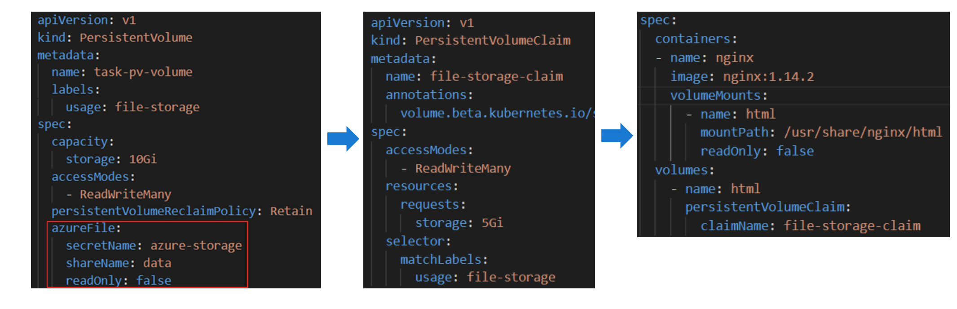
Static Persistent Volume Claims
Once a PersistentVolume has been created, it can be claimed by a PersistentVolumeClaim. The PVC can then be mounted as a volume in the Pod
This is an example of a Statically provisioned PersistentVolumeClaim.

Slide 16
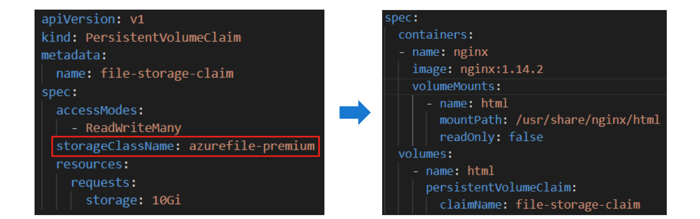
Dynamic Persistent Volume Claims
A PersistentVolumeClaim can also be provisioned dynamically by specifying the StorageClass (wrapper around driver) to use when creating the PVC.
A storage account is automatically created in the infrastructure resource group for use with the storage class to hold the Azure file shares.
NOTE: If the cluster is deleted (like cattle), all the resources in the infrastructure resource group, including dynamically provisioned file shares and disks, will also be deleted

Slide 17
Volumes & Secrets Demo
Module30-instructions
Exercise: Working with Persistent Volumes, Persistent Volume Claims and Secrets
Module6-Instructions:
Exercise: Using Secrets Stored in Azure Key Vault
Notes:
Module3-instructions:
Exercise: Working with Persistent Volumes, Persistent Volume Claims and Secrets
Module6-Instructions:
Exercise: Using Secrets Stored in Azure Key Vault

Slide 18
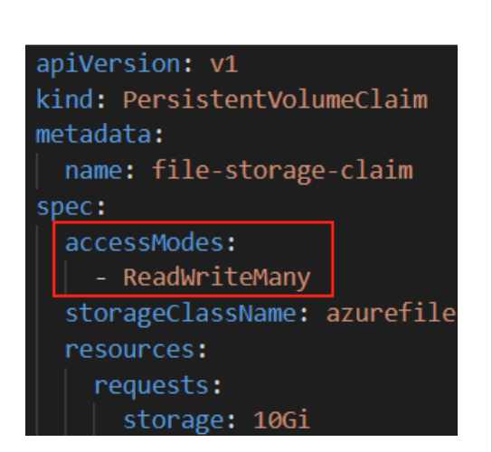
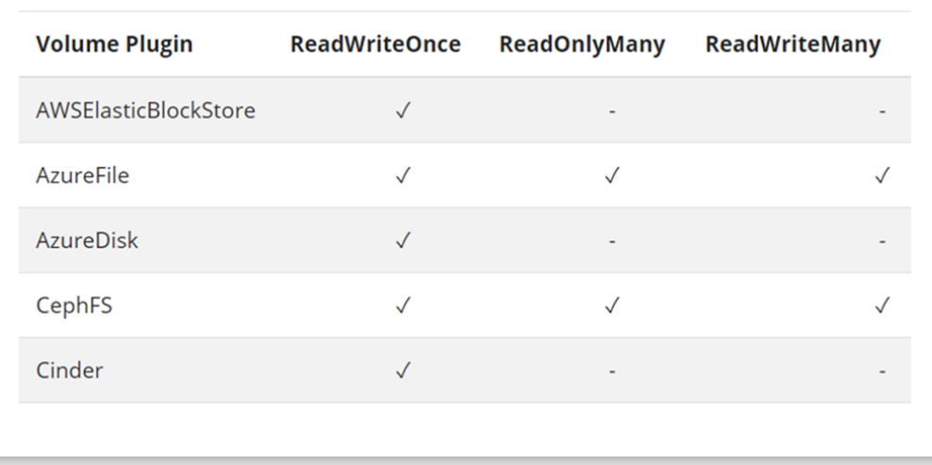
Persistent Volume Access Mode
Persistent Volumes support the following Access Modes, which determine how multiple Pods mount the same volume:
ReadWriteOnce (RWO) – Mount a volume as read-write by a single node.
ReadOnlyMany (ROX) – Mount the volume as read-only by many nodes.
ReadWriteMany (RWX) – Mount the volume as read-write by many nodes.
While the ReadWriteMany access mode would allow multiple Pods to share a volume across multiple Nodes, most external volume providers do not support this functionality.

Slide 19


Azure Storage Options
Azure Disk Storage
Azure File Storage
Azure Blob and Data Lake Storage
Azure NetApp Files via Trident
 | High, performance, durable block storage for Azure Virtual Machines | Simple, secure, and serverless enterprise-grade cloud file shares | Massively scalable and secure object storage and data lake | Enteprise file storage, powered by NetApp
Workloads | Databases, bigdata, cache, CI/CD | Shared/user workspace, CMS, databases, AI/ML | Analytics on data lake | Analytics, HPC, Custom apps currently using NetApp
Access protocol | SCSI | SMB, NFS v4.1 (preview) | Blobfuse, NFS v3.0 (preview) | NFS v3.0, NFS v4.1
Model | Static, Dynamic | Static, Dynamic | Static, Dynamic | Static, Dynamic
SKUs | Standard HDD, Standard SSD, Premium SSD, Ultra (v1.20) | Standard HDD, Premium SSD | Standard HDD, Premium SSD | Standard, Premium, Ultra
Access modes | ReadWriteOnly (RWO), ReadWriteMany (RWX) (v1.20) | RWO, RWX | RWO, RWX | RWO, RWX
Container type | Linux, Windows | Linux, Windows, ACI | Linux | Linux
Redundancy | Locally-redundant storage (LRS), Zone-redundant storage (ZRS) - coming soon | LRS, ZRS, Geo-redundant storage (GRS), Read-access geo-redundant storage (RAGRS) | LRS, ZRS, GRS, RAGRS | Single-zone
https://docs.microsoft.com/bs-latn-ba/azure/aks/concepts-storage

Slide 20
Multi-Container Pods
As a rule, most Pods only contain a single container. However, there are times when it makes sense to put multiple, related containers inside a single Pod.
Containers running in a Pod share the same IP, port and communicate using native inter-process communication channels (localhost).
Containers in a Pod also share the same lifecycle and are scaled together.
When one container fails, the status of the Pod changes to a non-running state, which prevents other containers from receiving traffic.
Pods Restarts count is the total number of restarts of all its containers.
Only highly-coupled related containers (those that interact with each other frequently) should be placed in the same Pod

Slide 21
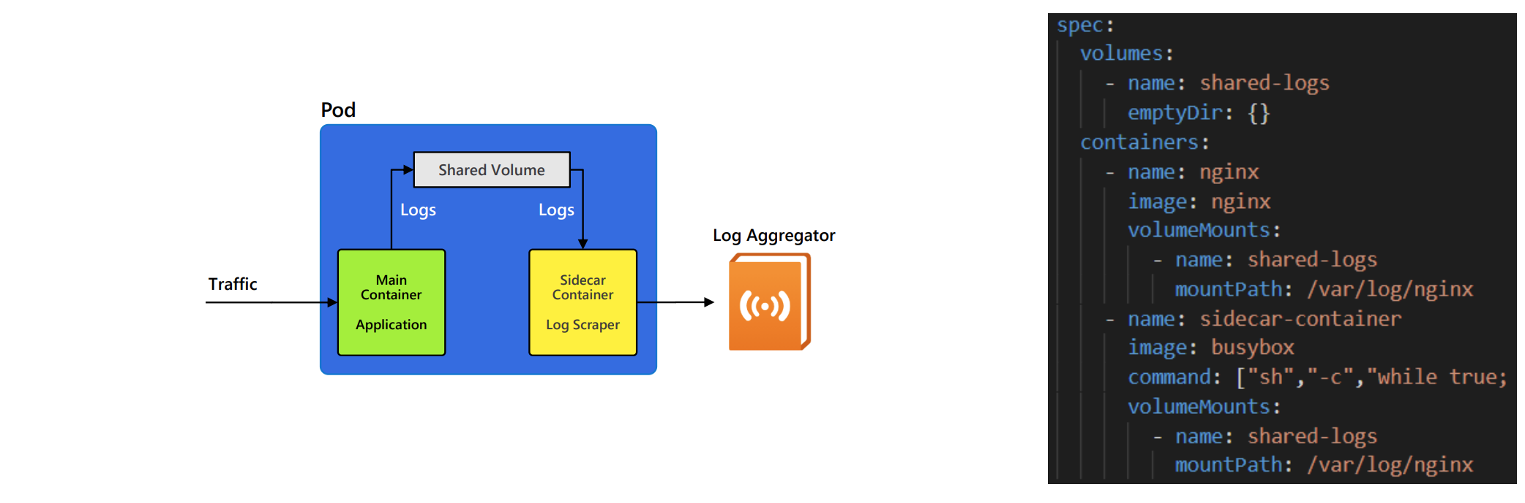
SideCar Pattern
A common scenario for using multiple container in a Pod is to implement the Sidecar Pattern
A Sidecar container is a second container added to the Pod definition because it needs to access the same resources being used by the main container.

Slide 22
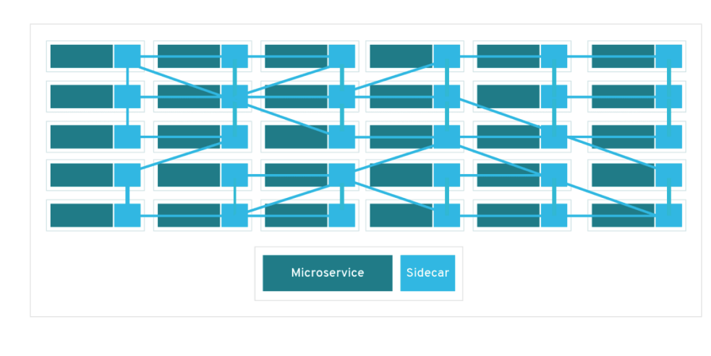
SideCar Envoy Proxy
The Envoy Proxy project implements the Sidecar pattern by automatically injecting an Envoy container into every Pod in a namespace.
Such a system is called a Service Mesh.
Service meshes provide microservices support services like:
Dynamic service discovery
Load balancing
Health checks
Encryption
Circuit breakers
Authentication/Authorization
Observability and Rich metrics
Istio, Linkerd and Microsoft’s Open Service Mesh are popular service meshes.

Slide 23
Multi-Container Pods Demo
Working with Multi-Container Pods

Slide 24
Init Containers
Sometimes containerized applications require dependencies (like external databases connection) to be available before they can start.
Some applications can’t start until costly initialization steps are performed.
Rather than adding initialization logic to every application, the process can be delegated to a separate initialization container.
Such an init container runs once before the main container is created
If initialization is successfully, the init container is deallocated and the main container is created.
If initialization fails, the Pod will keep restarting the init container. None of the main containers will be created until this step completes.
If multiple init containers are specified, each one is run one at a time, in the order they’re defined in the spec, until they all complete successfully.
After Pod startup, init containers are not listed as part of the Pod container inventory.

Slide 25
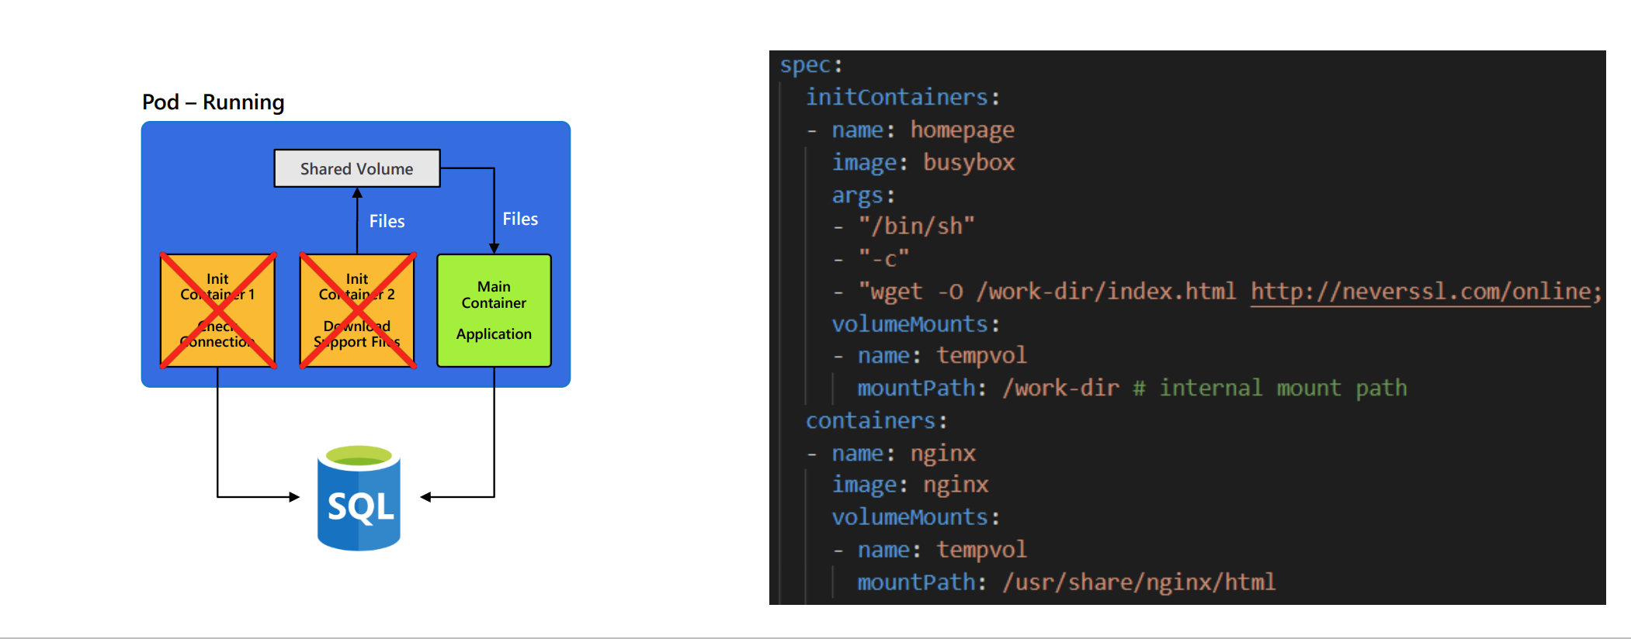
Running Init Containers
Creating and running init containers is part of the Pod start up process.
Pods do not reach a Running state until this process is completed successfully

Slide 26
Init Container Demo
Working with Init Container

Slide 27
Jobs and Cron Jobs
When Kubernetes controller detects a container has failed, it will attempt to restart it based on the container’s restartPolicy:
Always
Never
OnFailure
A Deployment controller expects Containers to run continuously (think of a web server or database server always listening for requests/queries).
The only restart policy a Deployment supports is Always.
Sometimes, you may want to run a Container that performs a finite task and then just stop.
Just like an Init Container, but without creating any other Containers afterwards.

Slide 28
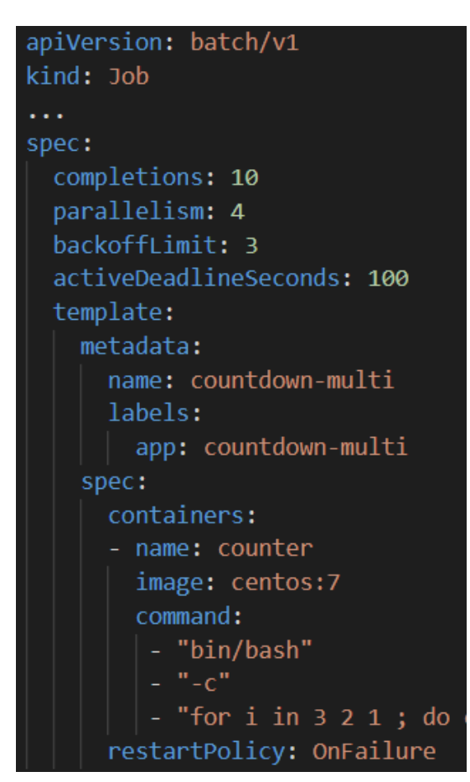
Jobs
A Job is a Kubernetes controller that creates and runs task-based workload.
A Job creates a Pod, whose Container(s) is expected to execute once, run for a short period of time and then stop.
When the Container ends its processing, the Pod goes into a Completed state.
A Job can specify that multiple Pods be created (completions) and how many Pods should be created at the same time (parallelism).
Containers defined in a Job only support Never and OnFailure restart policies.

Slide 29
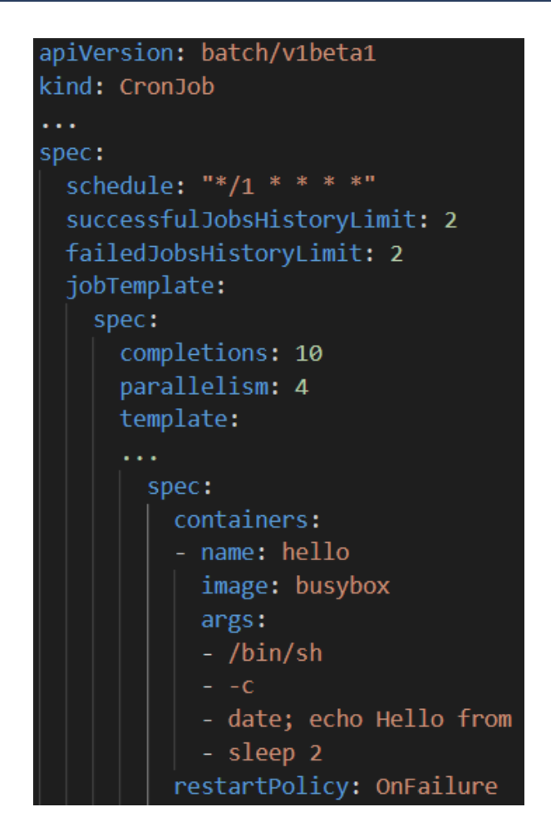
CronJobs
A CronJob is a Kubernetes controller that creates and manages Jobs according to a cron schedule.
CronJobs are useful for creating periodic and recurring tasks, like running backups or sending emails.
CronJobs maintain a certain number of successful and failed jobs, so their logs can be examined.
When a CronJob deletes a Job, that Job’s Pods are deleted

Slide 30
Jobs and CronJobs Demo
Working with Jobs and Scheduling jobs

Slide 31
Daemon Sets
DaemonSets are controllers that ensure new Nodes run an instance of a Pod.
As nodes are added to the cluster, Pods are scheduled on them automatically.
As nodes are removed from the cluster, those Pods are terminated.
Most system DaemonSets create Pods that can tolerate any taint.
Some typical uses for a DaemonSet are:
Running a cluster storage daemon on every node
Running a logs collection aggregator
Running a node monitoring agent on every node (Ex: omsagent for Azure Monitor).
Running a CSI Secrets provider (Ex: azure-secrets-provider for Azure Key Vault)

Slide 32
DaemonSets Demo
Exploring System DaemonSets

Slide 33
Health Checks
How do you know if a container has completed its start up sequence and is ready to accept requests?
What if a container is “running” but not functioning correctly?
For example, a webserver not receiving/processing requests
Kubelet uses probes to monitor running containers and determine if they’re running and/or can receive traffic from services.
Based on information it receives from probes, a Kubelet can restart containers or notify Kube-proxy to update its Endpoints and take Pods out of a service’s load balancer rotation

Slide 34
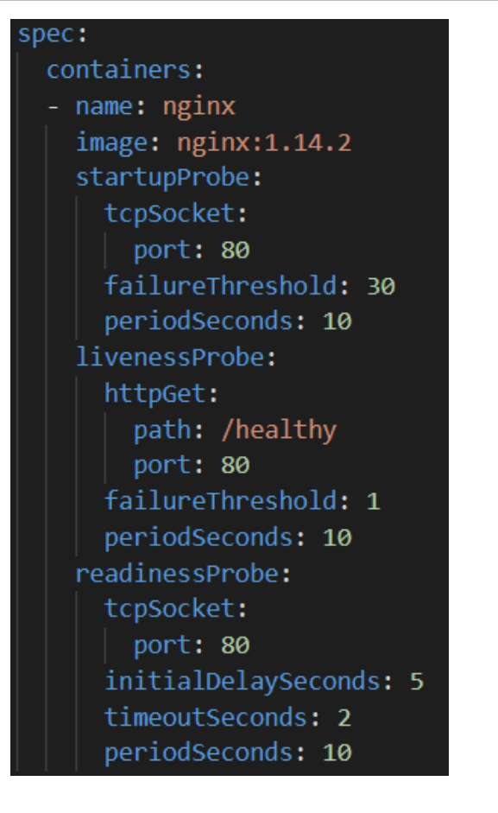
Startup, Liveness and Readiness Probes
There are three different types of probes available to attach to containers:
Startup Probe – Detects when an application has started. Some applications, like messaging servers, have extended startup sequences. Startup probes delay other probes from inadvertently telling the Kubelet restart the container for being unresponsive.
Liveness Probe – Once the application has started, a liveness probe monitors it periodically to ensure it’s still running and tell the Kubelet to restart the container if it doesn’t get a response.
Readiness Probe – Applications which service external requests, through a Service, can be monitored to ensure they are still receiving those requests. When they stop receiving requests, Readiness Probes can tell the Kubelet to exclude those pods from the service’s load balancer rotation.

Slide 35
Health Probe Demo
Using Health Probes to Monitor Containers

Slide 36
RBAC
Kubernetes Role Based Access Control ( RBAC) with Azure AD

Slide 37
Kubernetes Role-based Access Control (RBAC)
RBAC is a method of regulating access to resources based on the roles of individual users or service accounts within your organization. RBAC Components:
Service Account - Provides an identity for processes that run in a Pod.
Role – A list of rights (permissions) to specific resource types within a namespace.
RoleBinding – Defines the binding of a user/service account to a Role within a namespace
ClusterRole – A cluster-wide resource listing permissions for specific namespaces, all namespaces or cluster-scoped resources.
ClusterRoleBinding – Defines the binding of user/service account to a ClusterRole throughout the cluster

Slide 38
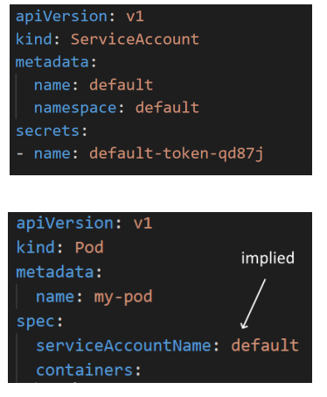
Service Accounts
Service Accounts are resources maintained by the Kubernetes API Server.
Each namespace has a default Service Account, that’s created when the namespace is created.
By default, all containers run in the context of the default Service Account.
Service Accounts are scoped within a namespace
NOTE: If a container is designed to interact with the API Server, it’s best practice NOT to use the default service account. Each application should create its own, Service Account.

Slide 39
User Accounts
Unlike Service Accounts, Kubernetes does not have objects which represent normal user accounts (no Kind: User).
Kubernetes supports several interfaces for external authentication.
Static Passwords or Tokens
X.509 Certificates
Single Sign-On using OpenID
Authentication Proxy
Webhook Token Authentication
Azure Active Directory can facilitate external user authentication into AKS clusters with OpenID Connect.
Externally authenticated users can be bound to Roles/ClusterRoles (RBAC), which facilitate resource authorization within the cluster.

Slide 40
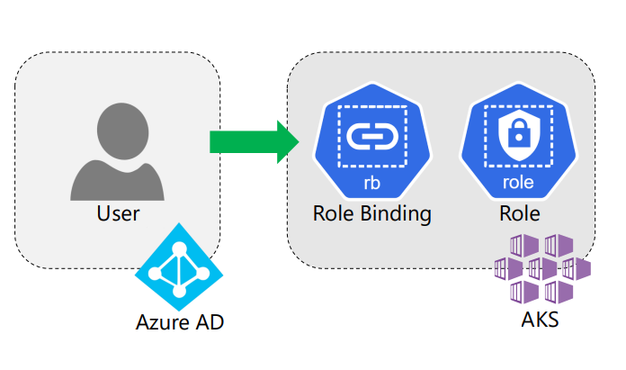
Kubernetes RBAC with Azure AD Integration
Kubernetes RBAC is enabled by default in AKS. Disabling RBAC is not recommended.
To enable Azure AD integration, use the --enable-aad option when creating or updating an AKS cluster.
Kubernetes RBAC works with Azure AD as follows:
A user is authenticated in Azure
The user’s token and email is passed to the cluster.
A RoleBinding resource binds the user to a Role, which define which actions are allowed on which Kubernetes resources.

Slide 41
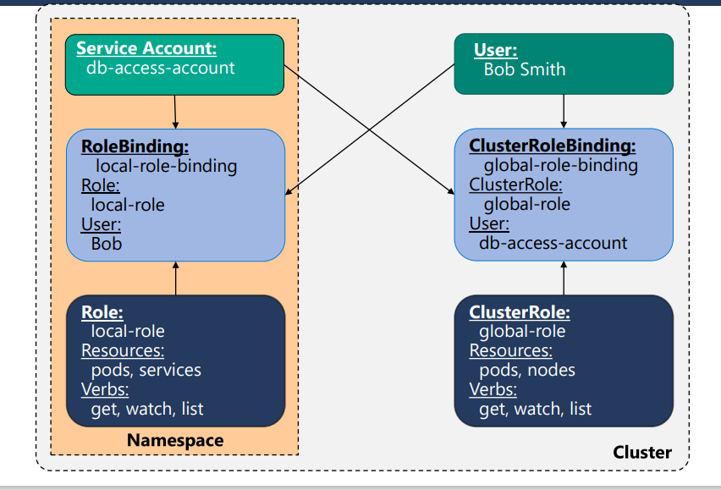
Kubernetes RBAC Illustrated

Slide 42
RBAC Demo
Review Roles and Bindings

